Slide 1
Scoileanna Ildánacha
CA Induction
9 October 2023
CS journey

Slide 2
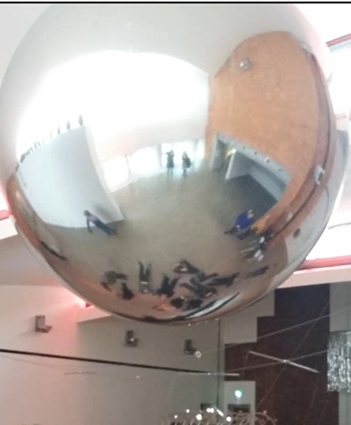
Creative Schools: ambitious objectives
To support schools and Youthreach centres to put the arts and creativity at the heart of children’s and young people’s lives
To support children and young people to develop, implement and evaluate
To draw on resources
To use as best practice the National Framework for the Participation of Children and Young People in Decision-making
Students from Scoil Bernadette Cork at the Crawford Gallery

Slide 3
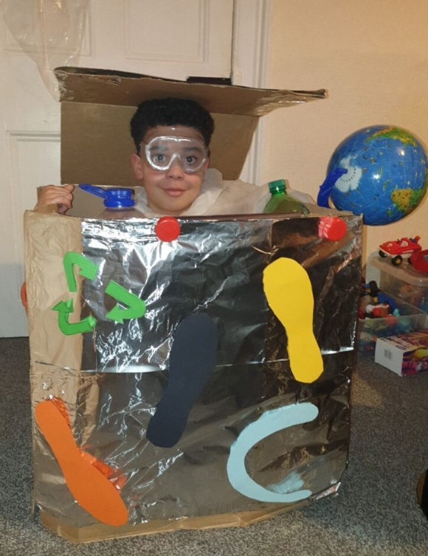
Method: Guided journey over two-years
To support schools and centres to
Phase 1
Explore and express what creativity means to their school community
Phase 2
Develop a Creative Schools Plan bespoke to their school/centre
Phase 3
Begin creative activity and projects identified in their Creative Schools Plan
North Monastery Primary School Cork

Slide 4
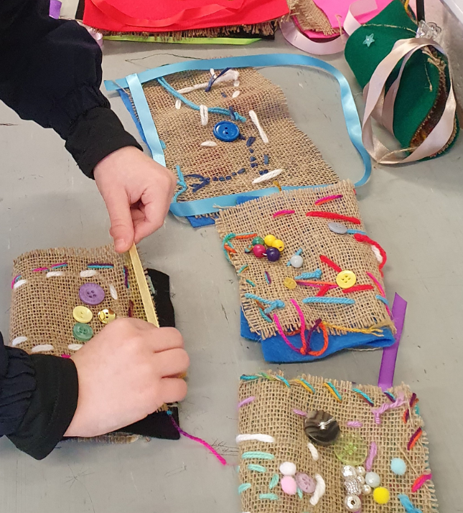
Supports for schools/centres to carry out CS journey
Support from a Creative Associate (up to nine days per year)
€4,000 grant for activities over two years
Training for the School Coordinator (a teacher)
Networking and participation in national initiatives, e.g. Creative Schools Week
Beady Pockets – Holy Family JS

Slide 5
Creative Schools journey a whole-school developmental process
Develop your Creative Schools Plan
Begin to implement your Creative Schools Plan
What does arts and creativity mean to you?
1
2
Understand phase
3
Planned projects and activities
Notes:
How does the Creative Schools initiative deliver these ambitious objectives? Through schools’ active participation in a developmental process to establish a Creative Schools Plan bespoke to each and every school and Youthreach centre taking part in the programme.

Slide 6
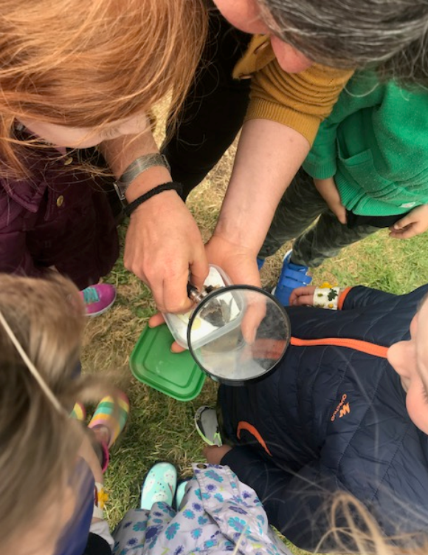
Creative Schools journey: Phase 1: ‘Understand’
What is art? What is creativity?
Exploration
Experimentation
Trying out
Consultation
Listening
Collation
Galway Educate Together NS

Slide 7
Creative Schools journey: Phase 1 ‘Understand’
This ‘understand’ phase can also include, for example:
Exploration of how Creative Schools can be aligned with and support the school’s existing development priorities.
Exploration how further development of arts and creativity in the school may be integrated into the School Self Evaluation, or other core strategies such as wellbeing audit.
Exploration of the relevance of arts and creativity to everyday school life, e.g. making friends, integrating new students, emblematic days, special celebrations, commemorations.
Support for professional development for teachers
Result from Phase 1:
A greater, shared understanding of what arts and creativity means to the students and the school community.

Slide 8
Creative Schools journey: Phase 2: Develop a plan
Developing the Creative School Plan
Reflection on all the creative and other outputs from the exploratory phase
Consultation
Consensus / voting / decisions
Drafting
Result from Phase 2:
A Creative Schools Plan – unique to the school/Youthreach centre.

Slide 9
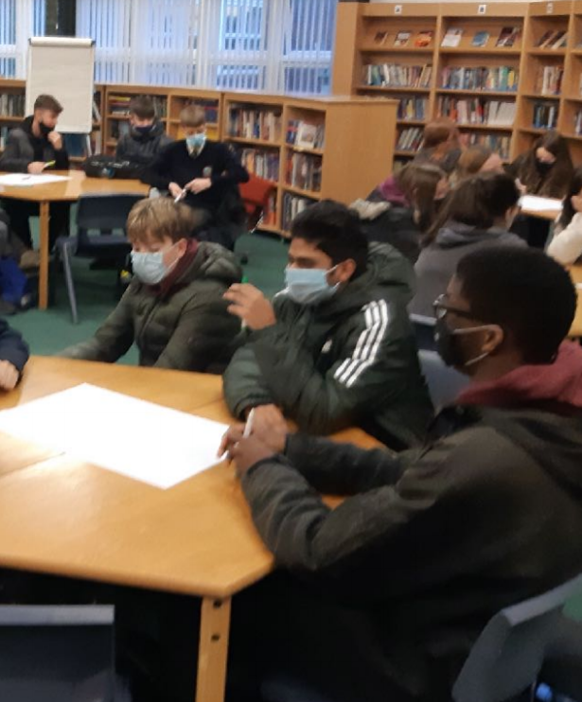
Phase 2: The school’s unique Creative Schools Plan
Vision and aims
Plan summary
Key activities, programmes, and projects
Coláiste Chiaráin, County Kildare

Slide 10
Phase 3: begin to carry out projects and activity from the plan
Activities and projects unique to each school/centre and include;
Collaborative projects creating new artistic works
Themed projects enabling cross-curricular work
Instigation of new fields of activity
Creative activity relevant to the curriculum; wellbeing; development goals
Students from Scoil Bernadette Cork at the Crawford Gallery

Slide 11
Phase 3: begin to carry out projects and activity from the plan
Characteristics of activity arising from schools’ and centres’ plans include;
Engaging with professional artists and other creative practitioners
Building relationships in the community
Supporting teacher creativity
Nurturing youth voice
Students from Scoil Bernadette Cork at the Crawford Gallery

Slide 12
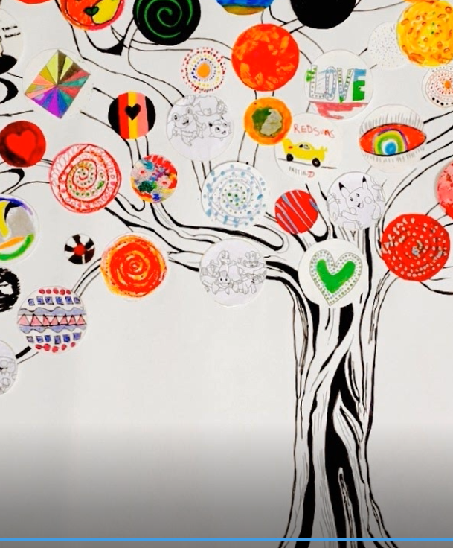
Creative Associates – assigned to support schools
Who?
Professional artists – all disciplines
Teachers with creative practice
You have specialist knowledge in the arts and education and you will help deepen the expertise that is already in the school community
Scoil Bernadette Cork

Slide 13
Understanding the role of the Creative Associate
What?
You support schools/centres to put the arts and creativity at the heart of the school community
You work with schools/centres to value and understand their starting point
You are a critical friend – you support and challenge schools/centres to think in new ways
You are there to help, support and advise schools/centres throughout their Creative Schools journey

Slide 14
Understanding the role of the Creative Associate
How?
Connect with the School Coordinator (SC)
Learn about the school/centre
Help to introduce CS to the school/centre – e.g:
Introductory CS workshops for teachers
Presentation to board
Help SC to design introductory creative activities for students to enable them to explore what creativity means to them
Use and prompt creative methods for exploration and consultation
Active listening

Slide 15
Understanding the role of the Creative Associate
Support the school to develop their Creative Schools Plan
Understand the important relationships that the school already has or would like to further
Help the school/centre connect with artists and to build relationships with arts and cultural organisations
You use your creative practice as part of the consultative process with the school. You advise and support the school to identify other artists/practitioners to facilitate and deliver projects in the school’s Creative Schools Plan

Slide 16
Your CS journey – a conversation with your school/centre
Communicating with your School Coordinator
Building a relationship with your school – you can use your practice to help this conversation
Prompting relationships across the school/centre
Prompting external relationships
Encouraging the school community to lead
Modelling creativity
Scoil Bernadette Cork

Slide 17
Resources for Creative Associates
Primary qualitative support from Regional Coordinators
Back up of the CS manager for your region
CA peer support and engagement
Contact CS team: creativeassociates@artscouncil.ie
Info about the National Framework for Children’s and Young
People’s Participation in Decision-making
https://hubnanog.ie/participation-framework/
Arts Council newsletter
https://www.artscouncil.ie/about-us/newsletter/

Slide 18
Programme of support and exchange
September 2023
CPW/Safeguarding training
October-December 2023
CA national training in Richmond Barracks
Meeting 1 with your Regional Coordinator (RC)
CA Community of Practice meeting 1
Regional training 1

Slide 19
Programme of support and exchange
January-June 2024
Meeting 2 with your RC
CA Community of Practice 2
Regional training 2
Spring Updates – a form to provide information about how your schools/centres are getting on
Meeting 3 with your RC to discuss the Spring Updates
CA Community of Practice 3

